Slide 1
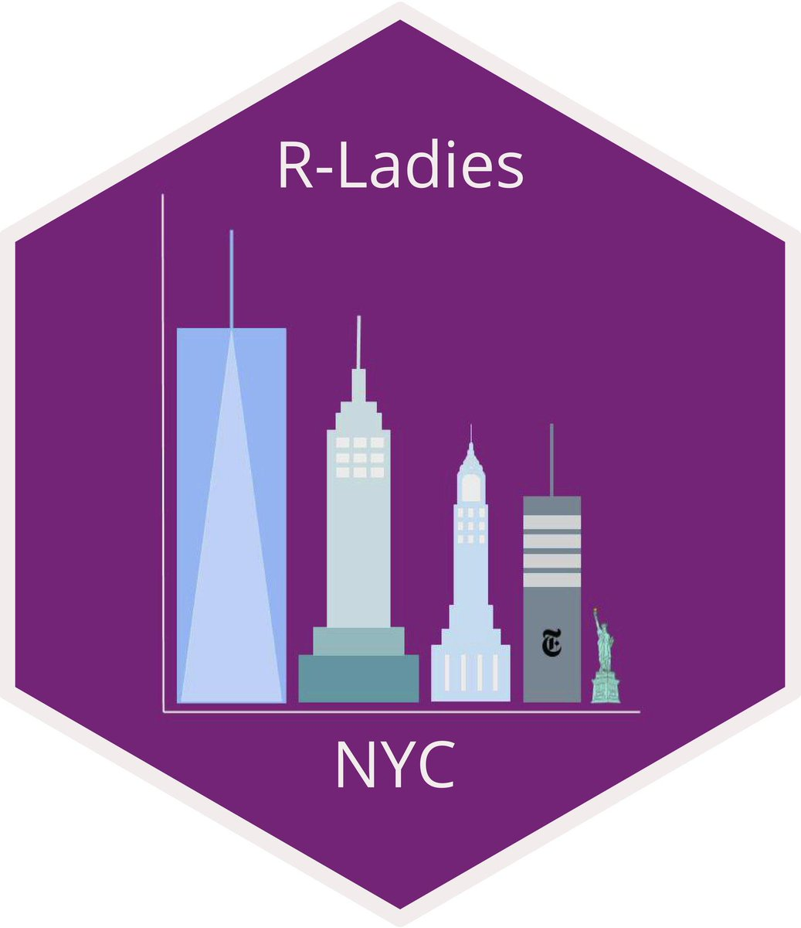
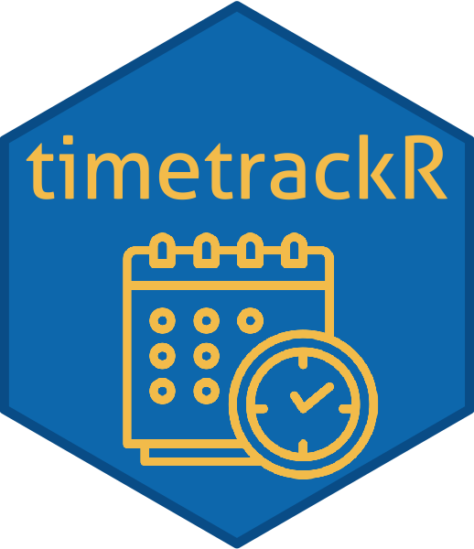


It’s Time to Shine with the timetrackR App
February 26, 2020
Jessica Lavery

Slide 2
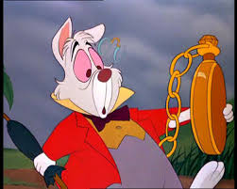

Time & the busy RLady
Often feels like there aren’t enough hours in the day
Start working on one project, check email, bounce to another project, maybe remember to go back to first project, and oh look! It’s 5pm
Long term: you have no recollection of how you’re spending your days

Slide 3
So what’s the problem?
It’s hard to manage your time if you don’t know how you’re spending your time
Notes:
Recall is often inaccurate: Feels like we spend a lot of time on projects we don’t love and not enough time on projects we do

Slide 4
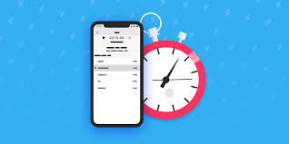
Potential solution: time tracking app?

Slide 5
Potential tools for tracking & analyzing your time
DIY | Other software (e.g. Toggl, RescueTime, Everhour)
Free | Free versions and paid versions with different capabilities
Full ownership of your recorded data, can set up and analyze in a way that best suits your needs | Preset metrics; can export your data and modify as needed for analysis
Self-report time spent per task | Turn on timer to start/stop tracking
Only knows what you tell it | Some can monitor apps and URLs used and identify distracters (hello Slack!)
Notes:
For me, having total control and ability to fully customize was important – also a few years ago a lot of these apps weren’t as well established/popularized
Some features like insights and saving reports are behind the paywall on Toggl
Wanted flexibility in terms of what was reported
Monitoring apps is geared more towards productivity – wasn’t concerned I wasn’t being productive, was more concerned about the long term flow of projects

Slide 6
Motivation for the DIY approach
Usability: Wanted simple, easily interpretable metrics/visualization – didn’t want to spend all of my time analyzing my time
Use for goal-setting and evaluating overall project flow
Aid in forecasting/resource allocation decisions
Professional development: Wanted experience with R & Shiny
Used previous RLadies presentation to get started: Learning Shiny with NBA data
Setting: On a team of 3 statisticians at the time
Project-based work with overlap in projects and investigators
Track individually or in aggregate
Notes:
Brief note that a lot of what I’m going to talk about has to do with the structure of my job, which is primarily project based across multiple investigators. While that specific scenario won’t hold for everyone here, the general concepts are applicable.

Slide 7

Thus, a (Shiny) star was born

Slide 8

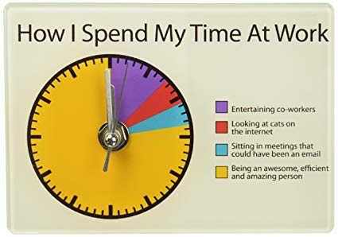
DIY Solution: timetrackR
Track time
timetrackR
Shiny App

Slide 9
Time tracking metrics & visualizations
Percent effort: Time spent per project/investigator/task
Total hours: Cumulative total number of hours spent on a project
Gantt Chart: Project phase by calendar time

Slide 10
Time tracking metrics: Percent effort
Allocated vs expended effort
Did an investigator ask for “quick help” on a project that is now taking up 30 hours a week?
Task management
As a statistician, what percentage of time is spent in meetings vs doing analyses? Does this need to be rebalanced?
Are the right projects/tasks being prioritized?
Comparing time invested to products generated
Did an abstract take as long as a full analysis for a manuscript?
For a time-intensive project, was the result multiple manuscripts?
Protecting your time
What percentage of my time am I spending on professional development? Is this more or less than I want it to be?
What percentage of my time am I spending on departmental activities (seminars, interviews, etc.) or other non-project work? Am I appropriately accounting for that when estimating how long it will take me to complete a project?

Slide 11
Time tracking metrics: Total hours
Useful metric for when re-analyses are requested
“We’ve spent 20 hours on the analysis, please circulate the manuscript draft before we complete additional analyses.”
Determining when to cut your losses and when to pursue a project further
“We’ve spent 200+ hours on this project and aren’t close to the deliverable. Is this even going to be feasible?”
“We’ve spent 100 hours on work for this conference presentation, should we turn it into a manuscript?”

Slide 12
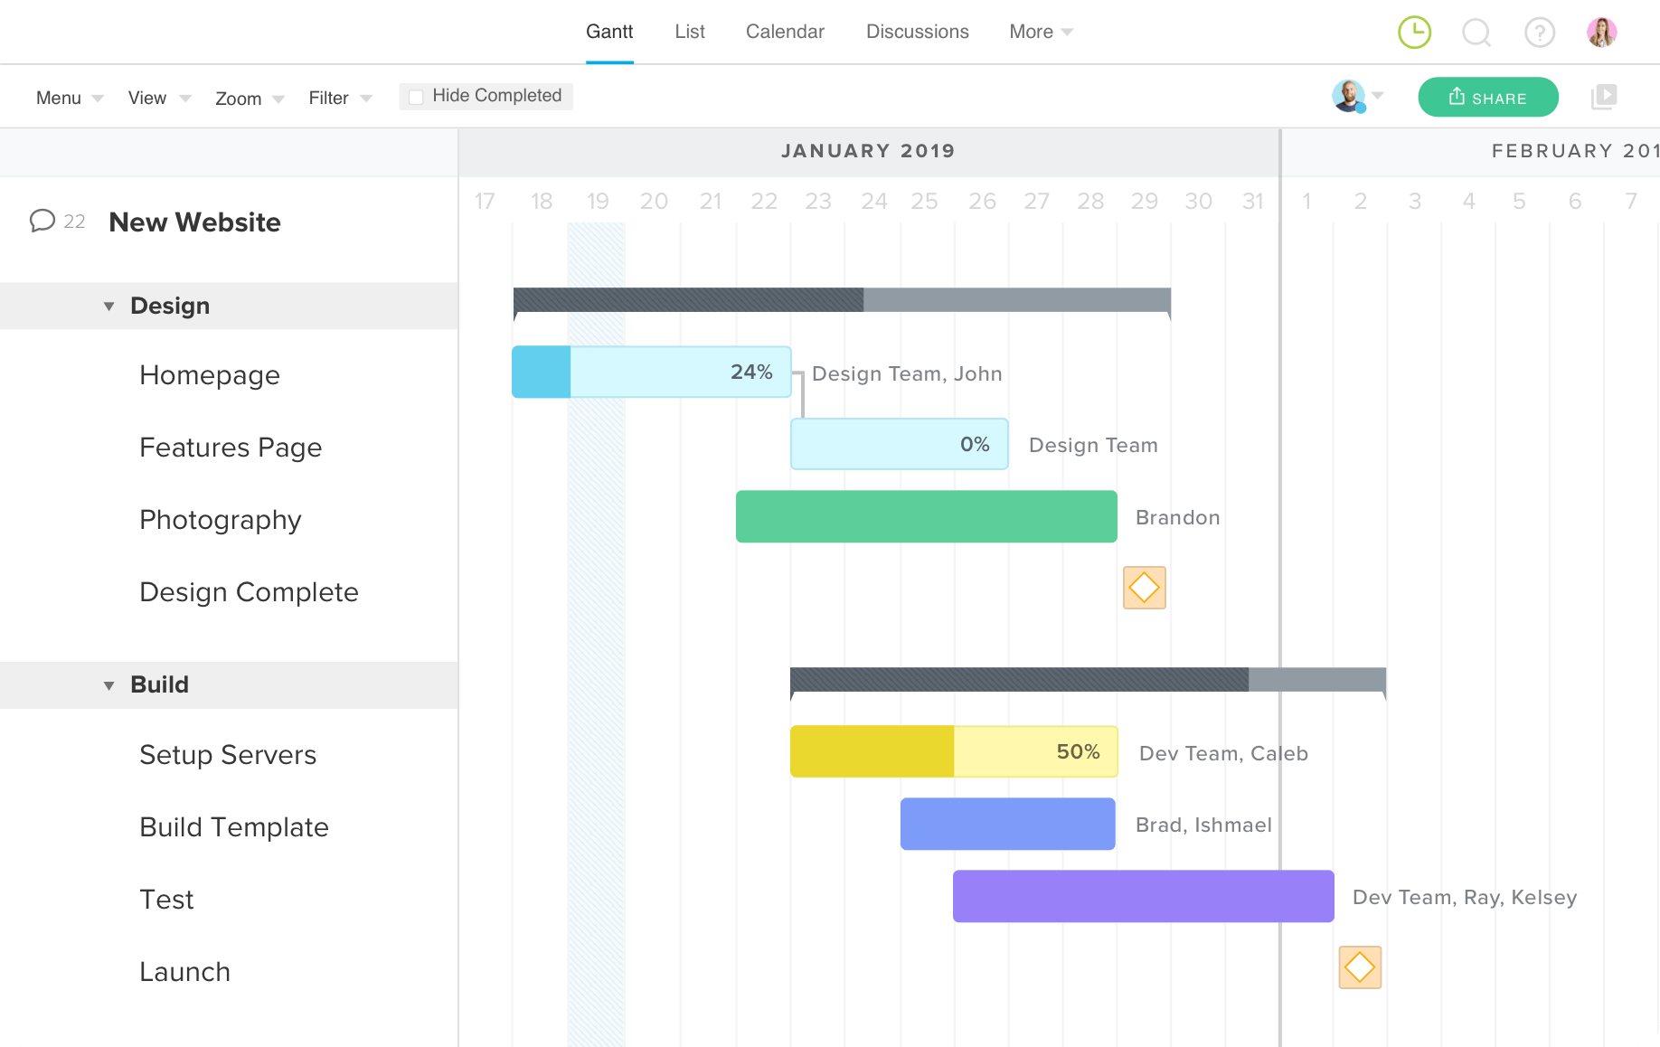
Time tracking viz: Gantt chart
Useful for a big picture overview of what projects are going on & when (and for how long)
Usually used prospectively, but good for a year in review when used retrospectively
Indicates transitions between analysis and re-analysis, indicates if analyses are happening after a manuscript is drafted, etc.
Want to see: Project planning -> Analysis -> Manuscript -> Revisions
Do not want to see: Analysis -> Manuscript -> Re-analysis -> Project Planning -> Analysis -> etc.

Slide 13
timetrackR Data
Started tracking my time in 2017
Previously at a Contract Research Organization where I had to bill my hours to specific projects, so I was used to tracking my time
Reasonably consistent: track 3-5 days/week
Spend <5 minutes a day tracking my time

Slide 14
timetrackR Demo

Slide 15
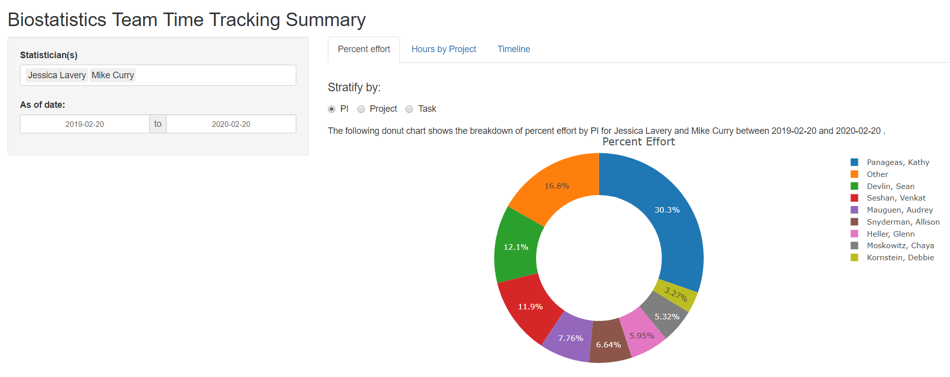
Notes:
Donut chart by project: change time from one year ago to six months ago, 3 months ago, this month
Change time to beginning 2017, look at hours by project

Slide 16
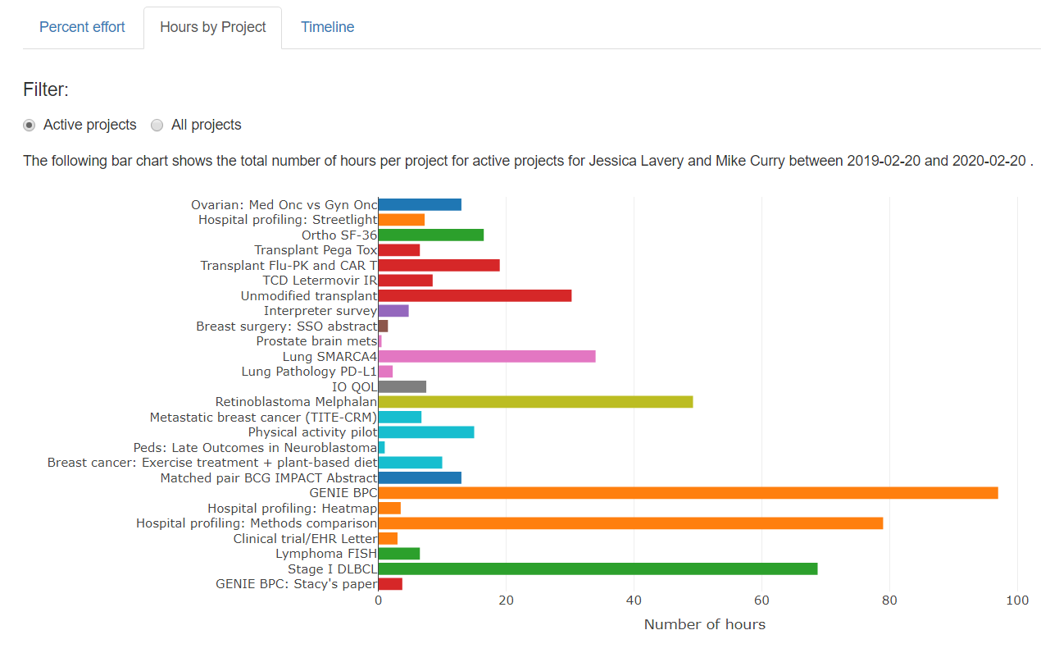

Slide 17
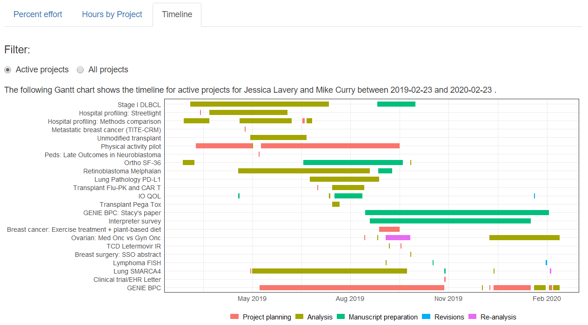

Slide 18
Information learned from timetrackR
In the last 3 months, >75% of my time has been devoted to a single project. Can we can bring someone else on to that project? (percent effort)
I spent more hours on a presentation for JSM than I thought I did. Maybe I should turn that into a manuscript? (total hours)
A particular project transitioned between analysis and re-analysis several times throughout the project’s life cycle. Is it time for a regroup with the investigator? (Gantt chart)

Slide 19
timetrackR in practice
Track time
Analyze time

Slide 20
Workflow: Initial Setup
Fork the GitHub repo
Includes a template time tracker and template project tracker tab
Time tracker is where you log your hours
Project tracker summarizes information like principal investigator (PI), deliverable, status, etc.

Slide 21
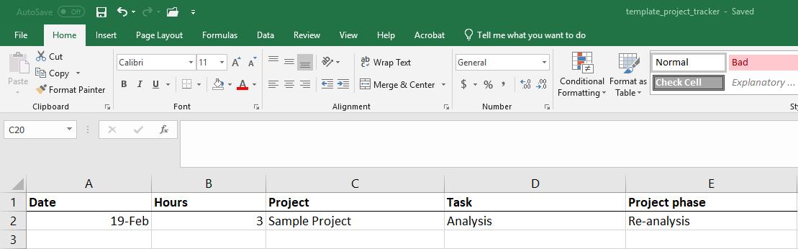

Template Time Tracker

Slide 22
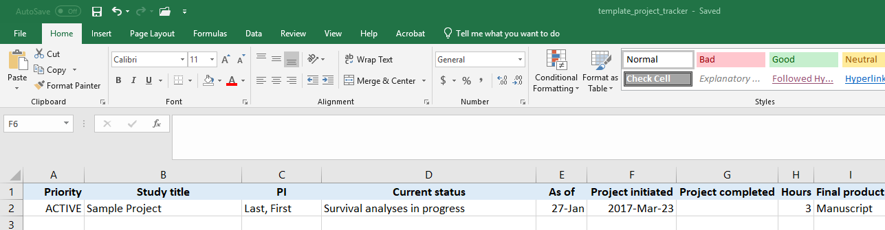

Template Project Tracker

Slide 23
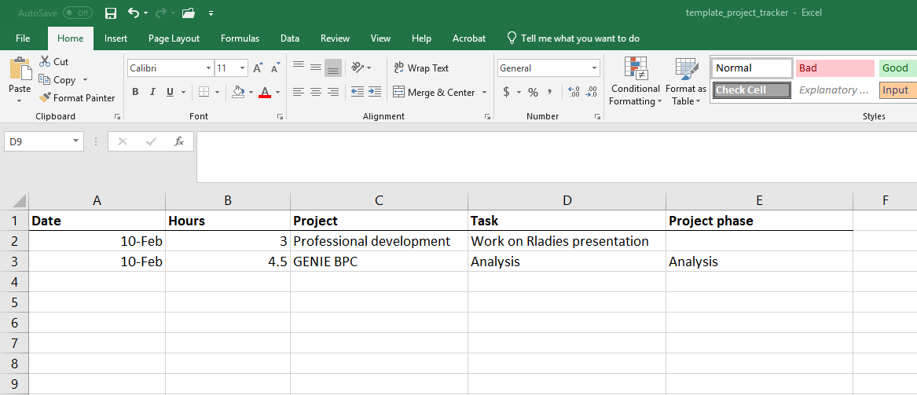
Workflow: Daily
Midday and/or end of day: Log your hours
Consistency is key so that projects are grouped appropriately

Slide 24
Workflow: Monthly? Quarterly?
Run the timetrackR app to summarize how you’ve been spending your time
Create data frames for shiny app
Will need to edit this program the first time running the app
May need to update to reflect project phases that are relevant to your work
Concatenate data from multiple team members
Identify active vs inactive projects
server: set of instructions to build the app
ui: defines a webpage that the user interacts with, it controls layout and appearance
Notes:
Highly recommend former Rladies talks on setting up Shiny apps, especially Julia Wrobel’s NBA Shiny App tutorial, which is available online and the link is on the earlier slide of this talk

Slide 25
R Code Highlights: The switch function and geom_segment()

Slide 26
The switch function
Used to update the figure depending on which input (statistician, date range, project status) is selected
To display the bar chart for active projects or for all projects:
Utilize radio button so that user can select active or all projects
Use the switch function to update the data frame depending on which is selected

Slide 27
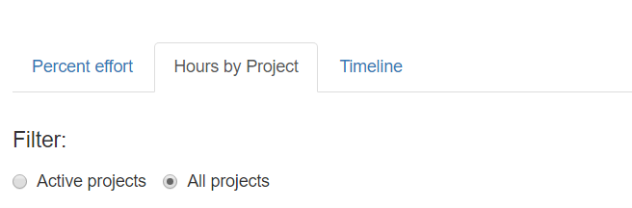
switch function: Bar chart application
App interface:
input$status_filter_bar returns either “Active projects” or “All projects” depending on which radio button is selected
Code (server.R):
Using switch function to subset the data on active projects if needed, otherwise proceeding with all projects
switch(input$status_filter_bar, "Active projects" = bar_filtered <- tracker %>% filter(status == "Active"), "All projects" = bar_filtered <- tracker)

Slide 28
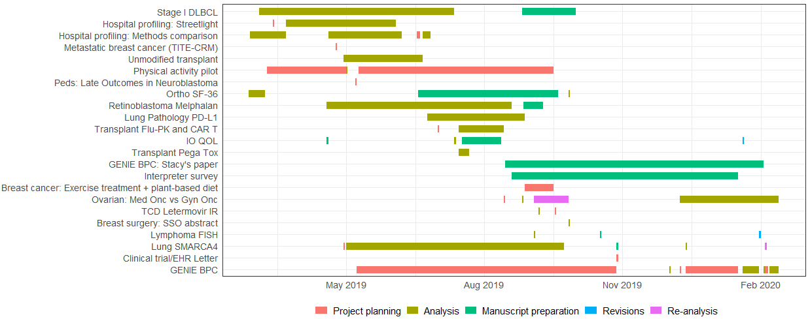
Gantt Chart
Made using ggplot with geom_segment()

Slide 29
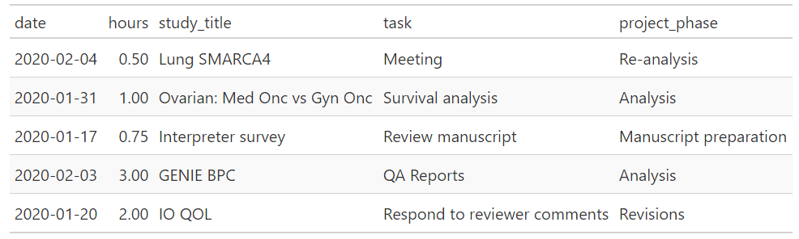
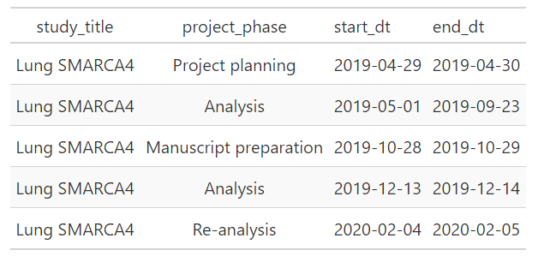
Gantt chart: Data wrangling
Summarize hourly data into project phase start / stop times

Slide 30
Gantt chart: Data Viz
ggplot(phase_filtered) + geom_segment(aes(x = start_dt, xend = end_dt, y = study_title, yend = study_title, colour = project_phase), size = 4) + theme_bw() + theme(legend.position = "bottom", legend.title = element_blank(), axis.title = element_blank(), axis.ticks = element_blank()) + scale_x_date(breaks = "3 months", date_labels = "%b %Y")

Slide 31
Hex Sticker

Slide 32
Caveats
Be careful about your denominators! This is a count of what you recorded
Won’t tell you if you spent 2 hours on Twitter or 45 minutes replying to an email (unless you write that down yourself!)
Corollary: this is only useful if you track your time relatively accurately
15 minute increments at a minimum, sometimes record a single project or activity for an entire day
Do what works best for you
Entirely retrospective: it’s a summary of what you’ve done, doesn’t include projected time allocations

Slide 33
Future Plans
Incorporate with Toggl app (or other) to automate a portion of the tracking
Automated time tracking + customizable reporting = best of both worlds?
Incorporate additional visualizations and/or summary measures
Changes over time?
Suggestions?

Slide 34
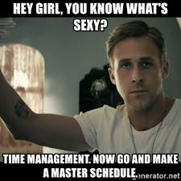
Summary
Very few metrics are needed to gain a general understanding of how you’re spending your time
Can be used to track time across a team or to look at your own time
Can be used to align (or re-align) your workflow with how you intend to spend your time
Notes:
For discussion: Do others do this? If so, how? In conjunction with management or separately?

Slide 35




Thank you!
https://github.com/jalavery/proj_mgmnt
laveryj@mskcc.org
Special thanks to Margie Hannum & Karissa Whiting for sharing their creative naming skills to come up with the name of both the app and this talk.
Thanks also to Mike Curry for letting me share his time tracking data and his patience in answering my many R questions.
@jessicalavs
www.JessicaLavery.com

